Slide 1
More Evidence for Circumstellar Material in Type Ia Supernovae from Echelle Spectroscopy?
M. M. Phillips
Carnegie Observatories

Slide 2
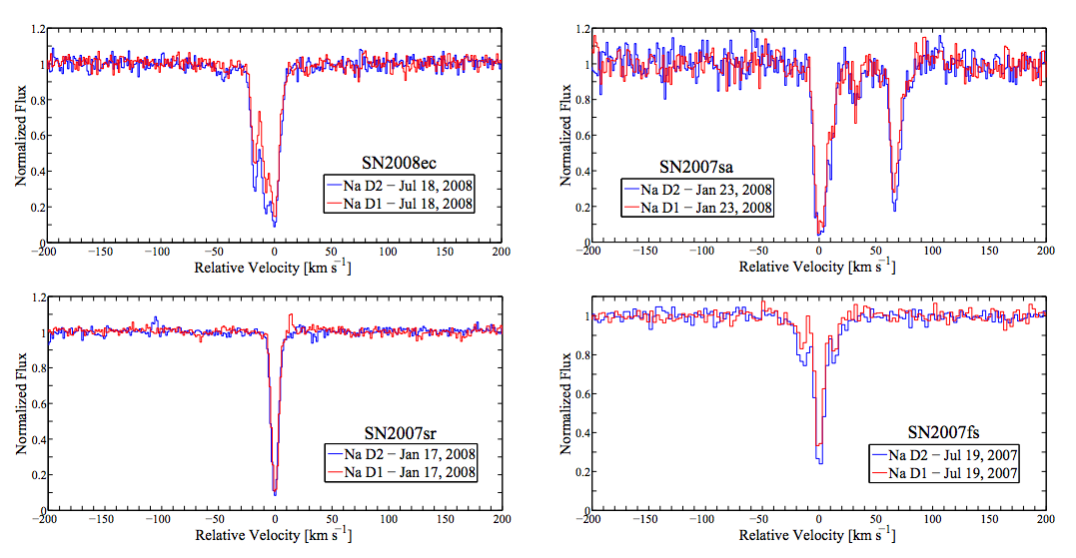
Sternberg et al. (2011)
Blueshifted
Redshifted
Single
Symmetric
Na I D absorption profiles produced by the Milky Way and host galaxy were classified into 4 broad categories

Slide 3
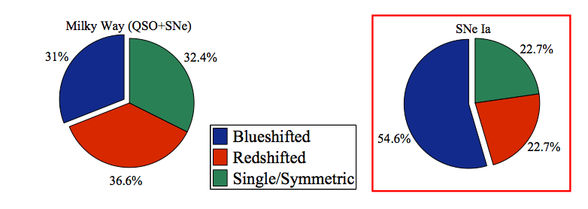
Sternberg et al. (2011)
The SN Ia sample displays a strong preference for blueshifted structures
The Milky Way sample shows no signiﬁcant preference
Blueshifted structures were interpreted as signatures of gas outﬂows from the supernova progenitor systems

Slide 4
In the Milky Way, the Na I column density correlates reasonably well with dust extinction
So does the K I column density, as well as the equivalent widths of certain diffuse interstellar bands (DIBs)
Do these features correlate with the host dust extinction derived from the optical and NIR light curves of SNe Ia?

Slide 5
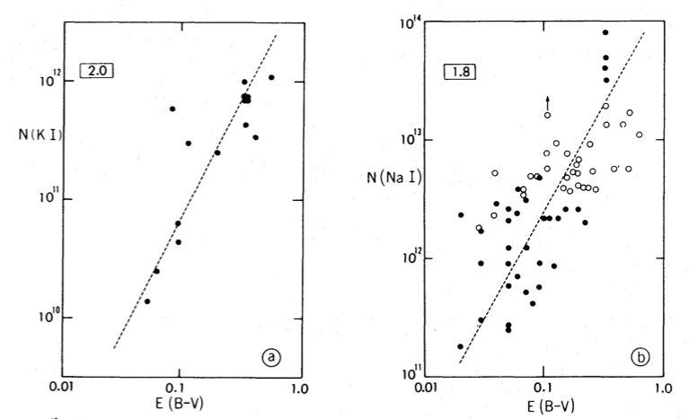
K I and Na I Column Densities vs. E(B-V) in the Milky Way
Hobbs (1974)

Slide 6
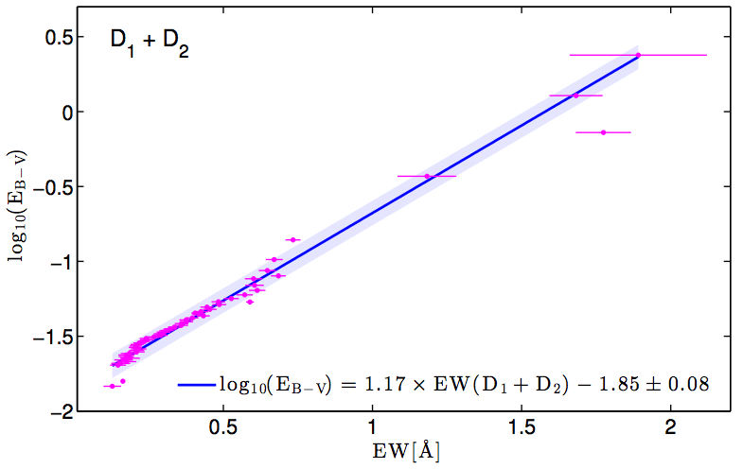
EW(Na I D)_{Milky Way} vs. E(B-V)
Poznanski, Prochaska, & Bloom (2012)

Slide 7
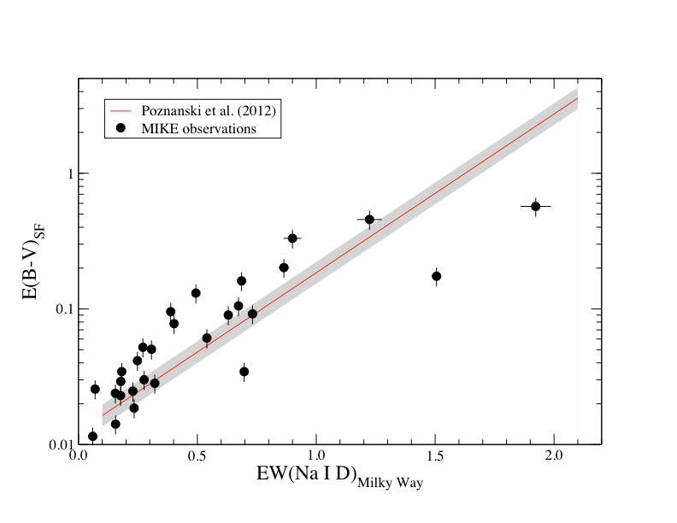
EW(Na I D)_{Milky Way} vs. E(B-V)

Slide 8
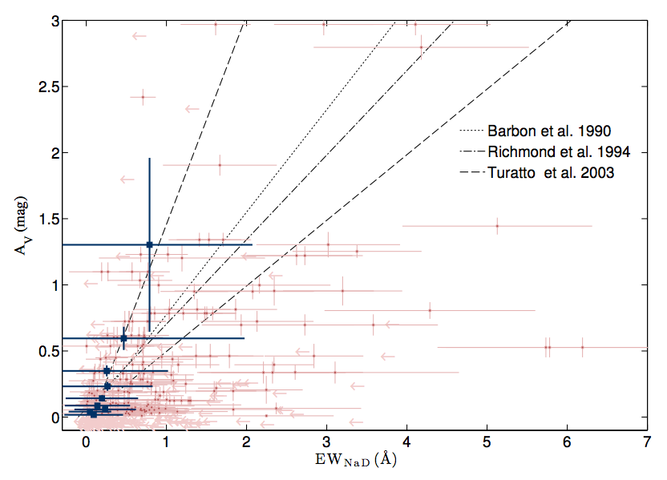
Interestingly, extending this technique to the host Na I D absorption doesn’t work well at all.
Poznanski et al. (2011)

Slide 9
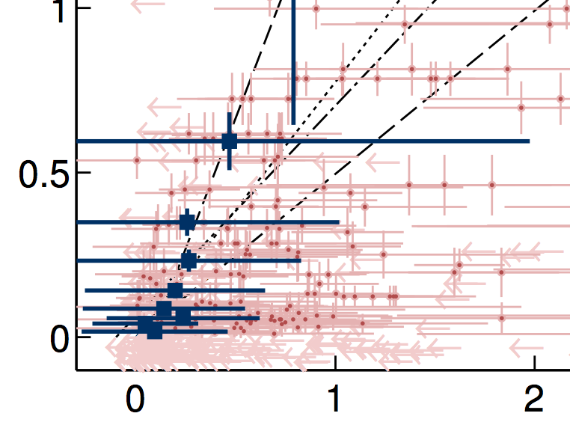
Why such a huge scatter? Note all the SNe with low A_{V} but EW(Na I D) ~ 1 Å
Poznanski et al. (2012)
?
Poznanski et al. (2011)

Slide 10
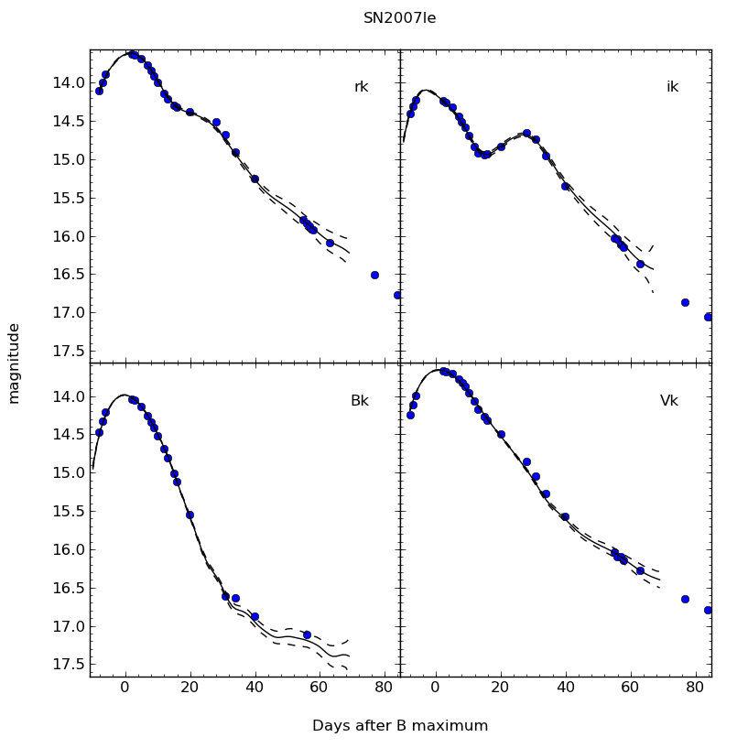
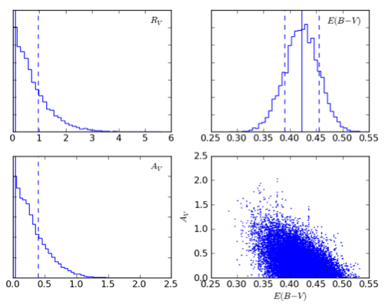
Optical + NIR photometry puts the tightest limits on A_{V}
SN 2007le
A_{V} < 0.39

Slide 11
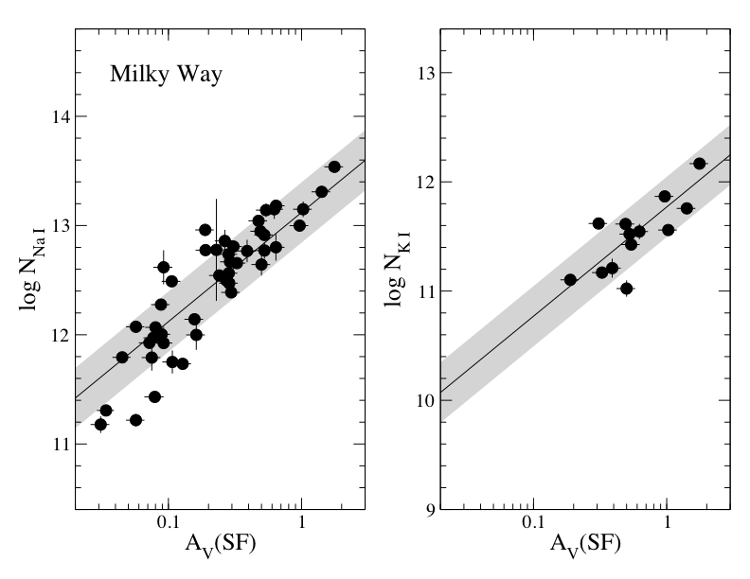
MIKE and HIRES Echelle spectra allow us to measure column densities for both Na I and K I lines in the Milky Way

Slide 12
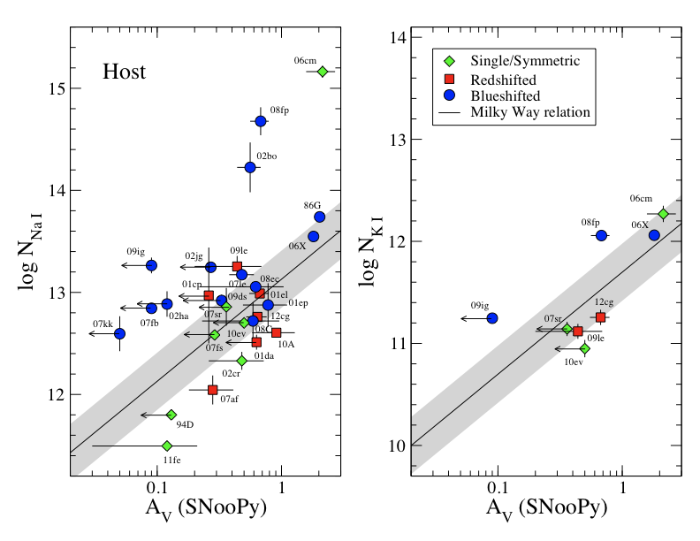
Host do the host column densities of Na I and K I compare with the extinction derived from the SN light curves?

Slide 13
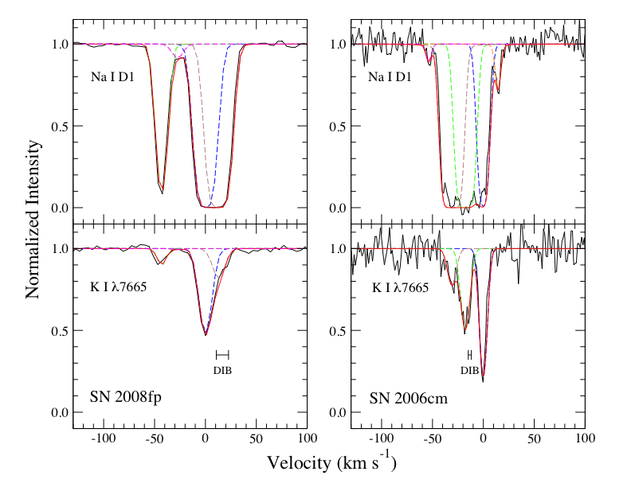
Sample fits

Slide 14
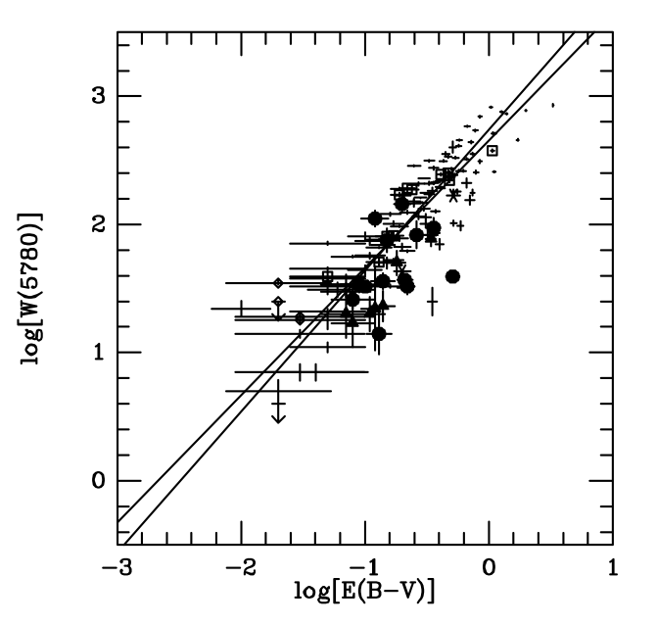
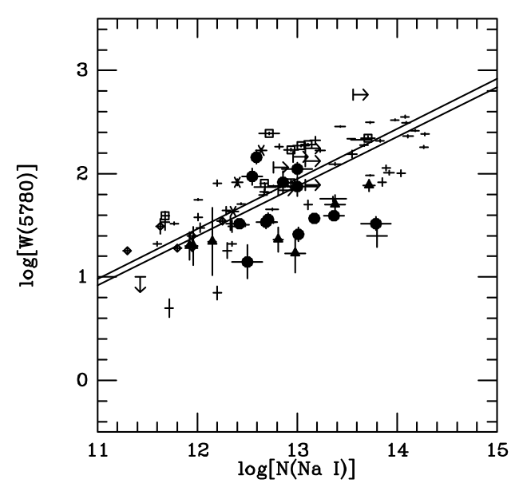
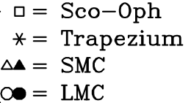
The equivalent width of the Diffuse Interstellar Band (DIB) at 5780 Å correlates with both A_{V} and log N(Na I) in the Milky Way & Magellanic Clouds
Correlation with A_{V} is tightest, with no significant difference observed between Milky Way and Magellanic Clouds
Welty et al. (2006)

Slide 15
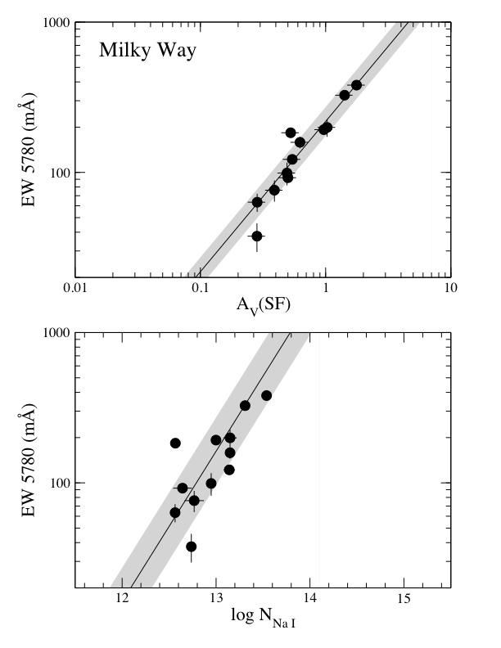
MIKE and HIRES Observations of the 5780 Å DIB in the Milky Way

Slide 16
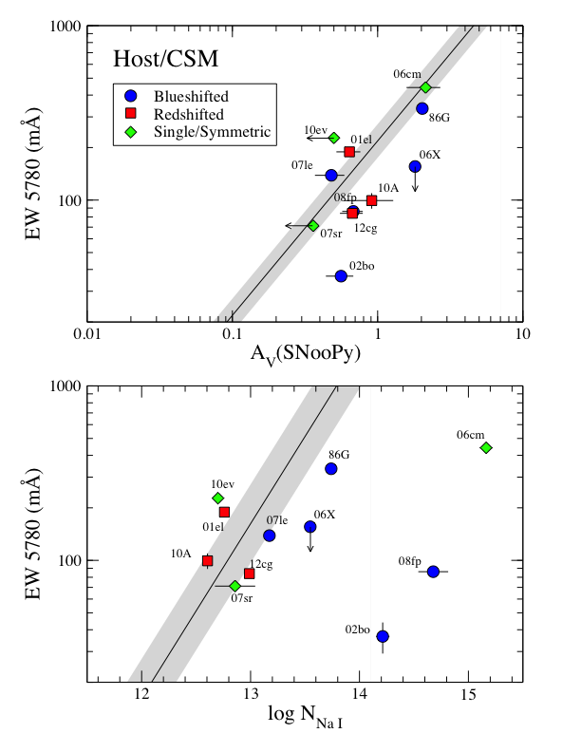
What do we see for the host DIB absorption?
DIB absorption correlates reasonably well with host A_{V} derived from light curves
DIB absorption vs. log N (Na I) shows much more scatter, especially for Blueshifted SNe

Slide 17
Conclusions and Speculations
K I column density and DIB 5780 Å EW correlate reasonably well with host A_{V} derived from SN light curves
Hypothesis: This reddening is associated with the host galaxy interstellar medium and not the SN itself
Na I column density shows poor correlation with host A_{V} with a high fraction of Blueshifted SNe show enhanced Na I D absorption
Wild speculation: This component arises in circumstellar material associated with the SN progenitor, and has little or no dust associated with it

